Slide 1
Problem Solving Techniques and Data Structures

Slide 2
Course Objectives
To introduce problem solving and develop the ability to analyze a given problem, understand and apply various techniques to solve problem.
To introduce the concepts of Data Structures

Slide 3
Session Plan
To understand problem solving, problem classification and problem solving techniques
To understand Data Structures, Why Data Structures, Types of Data Structures and operations permitted on different Data Structures

Slide 4
Introduction to Problem Solving Techniques
Notes:
Problem solving is an art rather than a science. Every problem can have several ways to solve. But the method which would help us in solving it effectively is the one we need to opt for. Before really attempting to solve a problem one has to put efforts to understand the problem clearly. A clear understanding is the most essential step in solving a problem.

Slide 5
Skills of Software Developer
The following are the ten skills to be possessed by a Software Developer
Analytical ability
Analysis
Design
Technical knowledge
Programming ability
Testing
Quality planning and Practice
Innovation
Team working
Communication
Notes:
Skill of a software developer

Slide 6
Performance measures
The following are the five points deciding the performance of a software developer
Timeliness
Quality of work
Customer Orientation
Optimal solution
Team satisfaction
Notes:
Performance measure of a software developer
Timeliness: How punctual is a software engineer in completing the assigned task
Quality of Work: If the task assigned has been done as per the quality norms prescribed by the company
Customer orientation: whether a Software Developer has understood the Customer requirements properly and able to communicate with him in terms of Domain.
Optimal solution: The ability

Slide 7
Problem-Definition
Definition: A problem is a puzzle that requires logical thought or mathematics to solve
What is Problem solving ?
The act of defining a problem; determining its cause; identifying, prioritizing and selecting alternatives for a solution; and implementing that solution.
Notes:
A problem is defined as “a discrepancy between the existing and a desired state of affairs”. Analyzing and understanding are two important activities that must be done to solve a problem. Apart from this, a software engineer should also be competent in technologies like operating systems, programming languages and databases, as he would be using these to solve a given problem with the help of a computer.

Slide 8
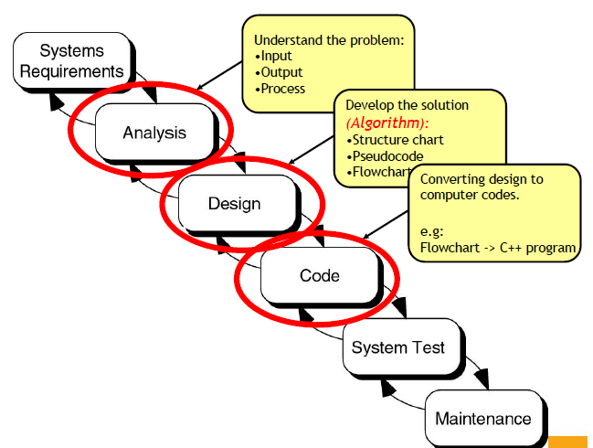
Problem Solving-Steps
Analyze and understand the Problem
Select a method to solve the problem
Design a solution
Develop the solution
Test the solution

Slide 9
Problem Classification
Concurrent: Operations overlap in time
Sequential: Operations are performed in a step-by-step manner
Distributed: Operations are performed at different locations
Event-Based: Operations are performed based on the input

Slide 10


Distributed/Concurrent Problems
Computers connected by a network
Notes:
Distributed Problem: when the problem is solved by various people from different location and then integrated. A large problem can be divided in to small sub problems and can be given to several people to solve.
Concurrent Problem: when 2 or more problem is solved at the same point of time, we call it a concurrent problem. Computers having more than one processor can support concurrent problem solving.

Slide 11
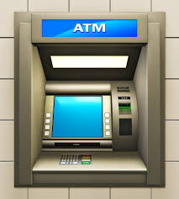
Sequential/Event based-Example
Insert ATM CARD
EXIT
Enter the Pin #
Collect the Card
Enter the amount
Collect Cash

Slide 12
Problem solving methods
Heuristic approach/ Brute Force technique
Greedy approach
Divide and Conquer technique
Dynamic Programming technique
Notes:
Some of the algorithmic design techniques are,
Brute force
Divide and conquer
Decrease and conquer
Transform and conquer Space and time tradeoffs
Greedy approach
Dynamic programming Iterative improvement Backtracking Branch and bound

Slide 13

Heuristic/ Brute Force approach
Brute force approach is a straight forward approach to solve the problem. It is directly based on the problem statement and the concepts
Brute force is a simple but a very costly technique
Example: Breaking Password
Watch the video to get more clarity on Heuristic approach
https://www.youtube.com/watch?v=ZINodNt-33g
Notes:
We will understand how an algorithm designed based on brute force technique works.

Slide 14
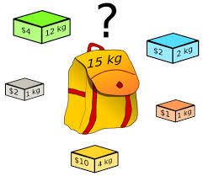
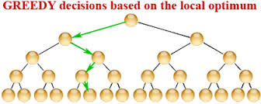
Greedy Approach
Greedy design technique is primarily used in Optimization problems
The Greedy approach helps in constructing a solution for a problem through a sequence of steps where each step is considered to be a partial solution. This partial solution is extended progressively to get the complete solution
The choice of each step in a greedy approach is done based on the following
It must be feasible
It must be locally optimal
It must be irrevocable
Example: TSP- Traveling Salesman Problem
https://www.youtube.com/watch?v=SC5CX8drAtU
Notes:
Optimization problems are problems where in we would like to find the best of all possible solutions. In other words we need to find the solution which has the optimal (maximum or minimum) value satisfying the given constraints.
In the greedy approach each step chosen has to satisfy the constraints given in the problem. Each step is chosen such that it is the best alternative among all feasible choices that are available. The choice of a step once made cannot be changed in subsequent steps.
We analyze an Activity – Selection Problem which works on the greedy approach.

Slide 15
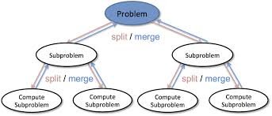
Divide-and-Conquer
The most-well known algorithm design strategy:
Divide instance of problem into two or more smaller instances
Solve smaller instances recursively
Obtain solution to original (larger) instance by combining these solutions
Example:
Binary Search
https://www.youtube.com/watch?v=wVPCT1VjySA
Divide and Conquer

Slide 16
Divide-and-Conquer Technique (cont.)
a problem of size n
subproblem 1
of size n/2
subproblem 2
of size n/2
a solution to
subproblem 1
a solution to
subproblem 2
a solution to
the original problem

Slide 17
What’s the difference?
Consider the problem of exponentiation: Compute a^{n}
Brute Force
Divide and conquer
Notes:
Try to get the students involved in coming up with these:
Brute Force:
a^{n}= a*a*a*a*...*a
n
Divide and conquer:
a^{n}= a^{n/2} * a^{n/2} (more accurately, a^{n}= a^{⎣n/2⎦} * a ^{⎡n/2│})
Decrease by one:
a^{n}= a^{n-1}* a (one hopes a student will ask what is the difference with brute force here:
there is none in the resulting algorithm, of course, but you can arrive
at it in two different ways)
Decrease by constant factor:
a^{n}= (a^{n/2})² (again, if no student asks about it, be sure to point out the difference
with divide and conquer. Here there is a significant difference that leads to a
much more efficient algorithm – in divide and conquer we recompute a^{n/2}

Slide 18
Dynamic Programming
Dynamic Programming is a design principle which is used to solve problems with overlapping sub problems
It solves the problem by combining the solutions for the sub problems
“Programming” here means “planning”
Main idea:
set up a recurrence relating a solution to a larger instance to solutions of some smaller instances
- solve smaller instances once
record solutions in a table
extract solution to the initial instance from that table
The difference between Dynamic Programming and Divide and Conquer is that the sub problems in Divide and Conquer are considered to be disjoint and distinct whereas in Dynamic Programming they are overlapping
Notes:
Dynamic Programming first appeared in the context of optimization problems. The term programming here refers to the tabular method to solve the problem. Fibonacci Series is an example of a problem which has overlapping sub problems. This can be best solved using Dynamic Programming when compared to Divide and Conquer strategy.
An already designed problem is taken and is optimized using Dynamic programming.

Slide 19
Dynamic Programming-Example
You have three jugs, which we will call A, B, and C. Jug A can hold exactly 8 cups of water, B can hold exactly 5 cups, and C can hold exactly 3 cups. A is filled to capacity with 8 cups of water. B and C are empty. We want you to find a way of dividing the contents of A equally between A and B so that both have 4 cups. You are allowed to pour water from jug to jug.

Slide 20
Solution
Step 1: First fill the 8L bucket full.
Step 2: Pour the water from 8L bucket to 5L bucket. Water remaining in 8L bucket is 3L.
Step 3: Pour the water from 5L bucket to 3L bucket. Water remaining in 5L bucket is 2L.
Step 4: Pour the water from 3L bucket to 8L bucket. Water in 8L bucket is 6L now and 3L bucket gets empty.
Step 5: Pour the water from 5L bucket to 3L bucket. Water in 3L bucket is 2L now and 5L bucket gets empty.
Step 6: Pour the water from 8L bucket to 5L bucket. Water remaining in 8L bucket is 1L 5L bucket gets full.
Step 7: Pour the water from 5L bucket to 3L bucket. Water remaining in 5L bucket is now 4L as 3L bucket already had 2L of water and when we poured water from 5l bucket to 3L bucket we poured 1L of water from 5L bucket and thus the remaining water in 5L bucket is now 4L.

Slide 21
Computer Based Problem Solving -Steps
Analysis of the Problem
Selecting a solution method
Draw Flowcharts
Develop Algorithms using Pseudo codes
Develop Program using Programming language
Test the program
Understand the Problem
Develop a Logic to solve
Represent the logic as a diagram
Write the step by step process of the Logic
Convert the steps into a program
Test the Program

Slide 22
Modeling Tools
Diagrammatic Representation of Logic
Different Types:
Flow Charts
Data flow Diagrams
Entity Relationship diagram
Unified Modeling Language

Slide 23
Flow Charts

Slide 24
Flow Charts
A flowchart is a diagrammatic
representation of an algorithm
A flow chart is an organized
combination of shapes, lines and text that graphically illustrates a process or structure
Symbols used
Notes:
Flow Charts are used to help programmers during the early stages of programming.
Flow Charts allow the programmer to set out, in a very simple way the sequence that he/she wants for each line of the program.
A flow chart is an organized combination of shapes, lines and text that graphically illustrates a process or structure.
Here's an example of how you could use shapes, lines, and text to build a chart:
The shapes (such as rectangles, circles, or diamonds) represent each step or decision point in the process.
The lines show the continuity of the process, demonstrating the paths the user should follow.
The text briefly describes each part of the process.
A flow chart can be used for:
defining and analyzing processes
building a step-by-step picture of the process for analysis, discussion, or communication purposes
defining, standardizing, or finding areas for improvement in a process

Slide 25
Example: Flow Chart (Sequential)
Find the average of three numbers

Slide 26
Flow Chart - Selectional
Is
average >=
65?

Slide 27
Example (Iterational)
Do the following for N input values. Read N from user
Write a program to find the average of a student given the marks he obtained in three subjects.
Then test whether he passed or failed.
For a student to pass, average should not be less than 65.
Notes:
Now lets extend the scope of our algorithms. The problem definition now needs to give us solution for a set of input values. This introduces to us the the concepts of looping constructs.
Loops are used when we want to execute a part of a program or a block of code to be executed several times.
Iterational constructs in general could be of two types:
Fixed – here the number of times the block of code to be executed is known before hand.
Variable – here the number of times the block of code to be executed is not known. Depending upon the user’s choice, the block could be executed many times.

Slide 28
Flow Chart – Example (Iterational)

Slide 29
Algorithm

Slide 30
Algorithm
An algorithm is a sequence of unambiguous instructions for solving a problem, i.e., for obtaining a required output for any legitimate input in a finite amount of time.
Recipe, process, method, technique, procedure, routine,… with following requirements:
The properties of an algorithm are as follows:
Finiteness
terminates after a finite number of steps
Definiteness
rigorously and unambiguously specified
Input
valid inputs are clearly specified
Output
can be proved to produce the correct output given a valid input
Effectiveness
steps are sufficiently simple and basic
Notes:
An Algorithm is defined as “Finite set of instructions to accomplish a task”.
An Algorithm has five properties as follows:
Finiteness: An algorithm should end in a finite number of steps.
Definiteness: Every step of an algorithm should be clear and unambiguously defined.
Input: The input of an algorithm can either be given interactively by the user or generated internally.
Output: An algorithm should have at least one output.
Effectiveness: Every step in the algorithm should be easy to understand and prove using paper and pencil.

Slide 31
Steps to develop Algorithm
Identify the Inputs and Outputs
Identify any other data and constants required to solve the problem
Identify what needs to be computed
Write an algorithm
problem
algorithm
“computer”
input
output

Slide 32
Algorithm – Example (1 of 2)
Find the average marks scored by a student in 3 subjects:
BEGIN
Step 1 : Accept 3 marks say Marks1, Marks2, Marks3 scored by the student
Step 2 : Add Marks1, Marks2, Marks3 and store the result in Total
Step 3 : Divide Total by 3 and find the Average
Step 4 : Display Average
END
Notes:
We will write an algorithm to find the average marks scored by a student in three subjects.
Read the problem statement and find out
what is the input required to solve the problem ( marks scored in 3 subjects in case of the example above)
What is the processing needed on the input that will generate the desired output (the marks are added and the total is divided by 3 to get average)
What is the output (the result we get is average which is displayed back to the user)
The above algorithm can be written in precise steps. This is given in the next slide.

Slide 33
Algorithm-Example (2 of 2)
Find the average marks scored by a student in 3 subjects:
BEGIN
Step 1 : Read Marks1, Marks2, Marks3
Step 2 : Sum = Marks1 + Marks2 + Marks3
Step 3 : Average = Sum / 3
Step 4 : Display Average
END

Slide 34
Different Patterns in Algorithms
Sequential
Sequential constructs execute the program in the order in which they appear in the program
Selectional (Conditional)
Selectional constructs control the flow of statement execution in order to achieve
the required result
Iterational (Loops)
Iterational constructs are used when a part of the program is to be executed several times
Notes:
While building solutions there are three major constructs on which our solutions are built up. They are
Sequential
Selectional (Conditional)
Iterational (loops)

Slide 35
Example - Selectional
Write an algorithm to find the average marks of a student. Also check whether the student has passed or failed.
For a student to pass, average marks should not be less than 65.
BEGIN
Step 1 : Read Marks1, Marks2, Marks3
Step 2 : Total = Marks1 + Marks2 + Marks3
Step 3 : Average = Total / 3
Step 4 : Set Output = “Student Passed”
Step 5 : if Average < 65 then Set Output = “Student Failed”
Step 6 : Display Output
END
Notes:
We have earlier written a program to find out the average marks of a student given marks in 3 subjects. Let us now extend the scope of the problem to find out whether is has passed our failed.
Now this introduces us to a next construct – the selectional construct
Step 1 : START
Step 2 : Accept marks1, marks2, marks3
Step 3 : sum = marks1, marks2, marks3
Step 4 : average=sum/3
Step 5 : if average >= 65 then display student has passed
else display the student has failed.
Step 6 : STOP

Slide 36
Example - Iterational
Find the average marks scored by ‘N’ number of students
BEGIN
Step 1 : Read NumberOfStudents
Step 2 : Counter = 1
Step 3 : Read Marks1, Marks2, Marks3
Step 4 : Total = Marks1 + Marks2 + Marks3
Step 5 : Average = Total / 3
Step 6 : Set Output = “Student Passed”
Step 7 : If (Average < 65) then Set Output = “Student Failed”
Step 8 : Display Output
Step 9 : Counter = Counter + 1
Step 10 : If (Counter <= NumberOfStudents ) then goto step 3
END

Slide 37
Pseudo Code
An algorithm is independent of any language or machine whereas a
program is dependent on a language and machine
To fill the gap between these two, we need pseudo codes
Pseudo-code is a way to represent the step by step methods in finding the solution to the given problem
Notes:
Algorithms are developed during the design phase of software engineering. During the design phase, we first look at the problem, try to write the “psuedo-code” and move towards the programming (implementation) phase.
It is a high level description of the algorithm
It is less detailed than the program
Will not reveal the design issues of the program
Uses English like language

Slide 38
Pseudo code - Example
Here's pseudo-code to add the two numbers:
Begin
int a, b, c;
input a, b
Let c= a + b;
output c;
End
Notes:
a,b,c are variables of integer type. Value for a and b are got from the user. The sum of a and b is stored in c. Output c is given out as result.

Slide 39
Pseudo codes (sequential)
BEGIN
Int a,b,c,avg;
Input a,b,c;
Let avg = (a+b+c)/3;
Output avg;
END

Slide 40
Pseudo codes (conditional)
Determine the largest number of A, B, C
Read A, B and C
If A is greater than B Then
If A is greater than C Then
Display A
Else
Display C
End If
Else
If B is greater than C Then
Display B
Else
Display C
End If
End If

Slide 41
Pseudo codes (iteration)
Pseudo code:
For emp # 1000 to 1500
Salary = salary + 10000
End for;
Notes:
Now lets extend the scope of our algorithms. The problem definition now needs to give us solution for a set of input values. This introduces to us the the concepts of looping constructs.
Loops are used when we want to execute a part of a program or a block of code to be executed several times.
Iterational constructs in general could be of two types:
Fixed – here the number of times the block of code to be executed is known before hand.
Variable – here the number of times the block of code to be executed is not known. Depending upon the user’s choice, the block could be executed many times.

Slide 42
Recap
Skills of a software developer
Problem classification
Problem solving approaches
Flow Chart
Algorithm patterns
Pseudo codes
Ver. No.:

Slide 43
Algorithm Design

Slide 44
Searching and Sorting
Searching refers to finding whether a data item is present in the set of items or not
Sorting refers to the arrangement of data in a particular order. That is, arranging items in a particular way
Sorting and searching have many applications in the area of computers

Slide 45
Searching Algorithms
The time required to search depends on the following factors:
Whether the data is arranged in a particular order or not
The location of the data to be searched
The total number of searches to be done
When the data is arranged in a particular order then, the time taken to search for the item is less.
Searching algorithms
Linear Search
Binary Search

Slide 46
Searching Algorithm

Slide 47
Linear Search: A Simple Search
A search traverses the collection until
The desired element is found
Or the collection is exhausted
If the collection is ordered, I might not have to look at all elements
I can stop looking when I know the element cannot be in the collection.

Slide 48
The Scenario
We have a sorted array
We want to determine if a particular element is in the array
Once found, print or return (index, boolean, etc.)
If not found, indicate the element is not in the collection
7 12 42 59 71 86 104 212

Slide 49
A Better Search Algorithm
Of course we could use our simpler search and traverse the array.
But we can use the fact that the array is sorted to our advantage.
This will allow us to reduce the number of comparisons.

Slide 50
Binary Search
Requires a sorted array or a binary search tree.
Cuts the “search space” in half each time.
Keeps cutting the search space in half until the target is found or has exhausted the all possible locations.

Slide 51
Binary Search Algorithm
look at “middle” element
if no match then
look left (if need smaller) or
right (if need larger)
1 7 9 12 33 42 59 76 81 84 91 92 93 99
Look for 42

Slide 52
The Algorithm
look at “middle” element
if no match then
look left or right
1 7 9 12 33 42 59 76 81 84 91 92 93 99
Look for 42

Slide 53
The Algorithm
look at “middle” element
if no match then
look left or right
1 7 9 12 33 42 59 76 81 84 91 92 93 99
Look for 42

Slide 54
The Algorithm
look at “middle” element
if no match then
look left or right
1 7 9 12 33 42 59 76 81 84 91 92 93 99
Look for 42

Slide 55
The Binary Search Algorithm
Return found or not found (true or false), so it should be a function.
When move left or right, change the array boundaries
We need a first and last index value.

Slide 56
The Binary Search Algorithm
calculate middle position
if (first and last have “crossed”) then
“Item not found”
elseif (element at middle = to_find) then
“Item Found”
elseif to_find < element at middle then
Look to the left
else
Look to the right

Slide 57
Looking Left
Use indices “first” and “last” to keep track of where we are looking
Move left by setting last = middle – 1
7 12 42 59 71 86 104 212
F
L
M
L

Slide 58
Looking Right
Use indices “first” and “last” to keep track of where we are looking
Move right by setting first = middle + 1
7 12 42 59 71 86 104 212
F
M
F
L

Slide 59
Binary Search Example – Found
7 12 42 59 71 86 104 212
F
M
L
Looking for 42

Slide 60
Binary Search Example – Found
7 12 42 59 71 86 104 212
F
M
L
Looking for 42

Slide 61
Binary Search Example – Found
7 12 42 59 71 86 104 212
F
M
L
42 found – in 3 comparisons

Slide 62
Binary Search Example – Not Found
7 12 42 59 71 86 104 212
F
M
L
Looking for 89

Slide 63
Binary Search Example – Not Found
7 12 42 59 71 86 104 212
F
M
L
Looking for 89

Slide 64
Binary Search Example – Not Found
7 12 42 59 71 86 104 212
F
L
M
Looking for 89

Slide 65
Binary Search Example – Not Found
7 12 42 59 71 86 104 212
L
F
89 not found – 3 comparisons

Slide 66
Sorting Techniques

Slide 67
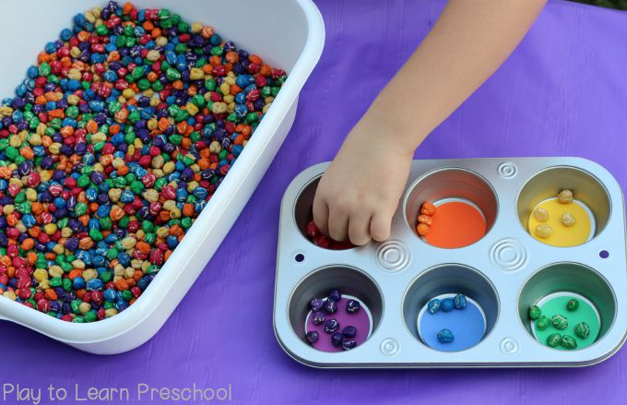
Sorting
Sorting is any process of arranging items systematically, and has two common, yet distinct meanings: ordering: arranging items in a sequence ordered by some criterion; categorizing: grouping items with similar properties.

Slide 68
Sorting
Sorting takes an unordered collection and makes it an ordered one.
1 2 3 4 5 6
77
42
35
12
101
5
1 2 3 4 5 6
5
12
35
42
77
101

Slide 69
Complexity of sorting Algorithm
The complexity of sorting algorithm calculates the running time of a function in which 'n' number of items are to be sorted. The choice for which sorting method is suitable for a problem depends on several dependency configurations for different problems. The most noteworthy of these considerations are:
The length of time spent by the programmer in programming a specific sorting program
Amount of machine time necessary for running the program
The amount of memory necessary for running the program

Slide 70
Types of Sorting Techniques
Bubble Sort
Selection Sort
Merge Sort
Insertion Sort
Quick Sort
Heap Sort

Slide 71
Bubble sort - "Bubbling Up" the Largest Element
Traverse a collection of elements
Move from the front to the end
“Bubble” the largest value to the end using pair-wise comparisons and swapping
1 2 3 4 5 6
77
42
35
12
101
5

Slide 72
"Bubbling Up" the Largest Element
Traverse a collection of elements
Move from the front to the end
“Bubble” the largest value to the end using pair-wise comparisons and swapping
Swap
1 2 3 4 5 6
42
77
77
42
35
12
101
5

Slide 73
"Bubbling Up" the Largest Element
Traverse a collection of elements
Move from the front to the end
“Bubble” the largest value to the end using pair-wise comparisons and swapping
1 2 3 4 5 6
Swap
35
77
42
77
35
12
101
5

Slide 74
"Bubbling Up" the Largest Element
Traverse a collection of elements
Move from the front to the end
“Bubble” the largest value to the end using pair-wise comparisons and swapping
1 2 3 4 5 6
Swap
12
77
42
35
77
12
101
5

Slide 75
"Bubbling Up" the Largest Element
Traverse a collection of elements
Move from the front to the end
“Bubble” the largest value to the end using pair-wise comparisons and swapping
1 2 3 4 5 6
42
35
12
77
101
5
No need to swap

Slide 76
"Bubbling Up" the Largest Element
Traverse a collection of elements
Move from the front to the end
“Bubble” the largest value to the end using pair-wise comparisons and swapping
1 2 3 4 5 6
Swap
5
101
42
35
12
77
101
5

Slide 77
"Bubbling Up" the Largest Element
Traverse a collection of elements
Move from the front to the end
“Bubble” the largest value to the end using pair-wise comparisons and swapping
1 2 3 4 5 6
101
42
35
12
77
5
Largest value correctly placed

Slide 78
Items of Interest
Notice that only the largest value is correctly placed
All other values are still out of order
So we need to repeat this process
1 2 3 4 5 6
101
42
35
12
77
5
Largest value correctly placed

Slide 79
Selection sort

Slide 80
Selection Sort
Idea:
Find the smallest element in the array
Exchange it with the element in the first position
Find the second smallest element and exchange it with the element in the second position
Continue until the array is sorted
Disadvantage:
Running time depends only slightly on the amount of order in the file

Slide 81
Selection Sort
Example: we are given an array of six integers that we want to sort from smallest to largest
[0] [1] [2] [3] [4] [5]
Notes:
The picture shows a graphical representation of an array which we will sort so that the smallest element ends up at the front, and the other elements increase to the largest at the end. The bar graph indicates the values which are in the array before sorting--for example the first element of the array contains the integer 45.

Slide 82
Selection Sort
Start by finding the smallest entry.
[0] [1] [2] [3] [4] [5]
Notes:
The first sorting algorithm that we'll examine is called Selectionsort. It begins by going through the entire array and finding the smallest element. In this example, the smallest element is the number 8 at location [4] of the array.

Slide 83
Selection Sort
Swap the smallest entry with the first entry.
[0] [1] [2] [3] [4] [5]
Notes:
Once we have found the smallest element, that element is swapped with the first element of the array...

Slide 84
Selection Sort
Swap the smallest entry with the first entry.
[0] [1] [2] [3] [4] [5]
Notes:
...like this.
The smallest element is now at the front of the array, and we have taken one small step toward producing a sorted array.

Slide 85
Selection Sort
Sorted side
Unsorted side
Part of the array is now sorted.
[0] [1] [2] [3] [4] [5]
Notes:
At this point, we can view the array as being split into two sides: To the left of the dotted line is the "sorted side", and to the right of the dotted line is the "unsorted side". Our goal is to push the dotted line forward, increasing the number of elements in the sorted side, until the entire array is sorted.

Slide 86
Selection Sort
Sorted side
Unsorted side
Find the smallest element in the unsorted side.
[0] [1] [2] [3] [4] [5]
Notes:
Each step of the Selectionsort works by finding the smallest element in the unsorted side. At this point, we would find the number 15 at location [5] in the unsorted side.

Slide 87
Selection Sort
Sorted side
Unsorted side
Swap with the front of the unsorted side.
[0] [1] [2] [3] [4] [5]
Notes:
This small element is swapped with the number at the front of the unsorted side, as shown here...

Slide 88
Selection Sort
Sorted side
Unsorted side
We have increased the size of the sorted side by one element.
[0] [1] [2] [3] [4] [5]
Notes:
...and the effect is to increase the size of the sorted side by one element.
As you can see, the sorted side always contains the smallest numbers, and those numbers are sorted from small to large. The unsorted side contains the rest of the numbers, and those numbers are in no particular order.

Slide 89
Selection Sort
Sorted side
Unsorted side
Smallest
from
unsorted
The process continues...
[0] [1] [2] [3] [4] [5]
Notes:
Again, we find the smallest entry in the unsorted side...

Slide 90
Selection Sort
Sorted side
Unsorted side
The process continues...
Swap
with
front
[0] [1] [2] [3] [4] [5]
Notes:
...and swap this element with the front of the unsorted side.

Slide 91
Selection Sort
Sorted side
is bigger
Sorted side
Unsorted side
The process continues...
[0] [1] [2] [3] [4] [5]
Notes:
The sorted side now contains the three smallest elements of the array.

Slide 92
Selection Sort
The process keeps adding one more number to the sorted side.
The sorted side has the smallest numbers, arranged from small to large.
Sorted side
Unsorted side
[0] [1] [2] [3] [4] [5]
Notes:
Here is the array after increasing the sorted side to four elements.

Slide 93
Selection Sort
We can stop when the unsorted side has just one number, since that number must be the largest number.
Sorted side
Unsorted side
[0] [1] [2] [3] [4] [5]
Notes:
And now the sorted side has five elements.
In fact, once the unsorted side is down to a single element, the sort is completed. At this point the 5 smallest elements are in the sorted side, and so the the one largest element is left in the unsorted side.
We are done...

Slide 94
“Divide and Conquer”
Very important strategy in computer science:
Divide problem into smaller parts
Independently solve the parts
Combine these solutions to get overall solution
Idea 1: Divide array into two halves, recursively sort left and right halves, then merge two halves → Mergesort
Idea 2 : Partition array into items that are “small” and items that are “large”, then recursively sort the two sets → Quicksort

Slide 95
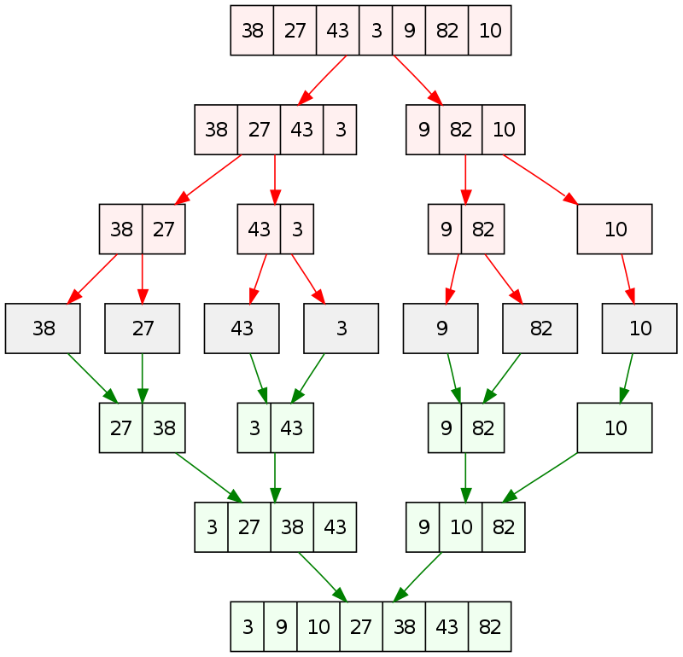
Mergesort

Slide 96
Quick Sort
Quick Sort is based on the Divide and Conquer rule.
It is also called partition-exchange sort. This algorithm divides the list into three main parts:
Elements less than the Pivot element
Pivot element(Central element)
Elements greater than the pivot element

Slide 97
Quick Sort
Pivot element can be any element from the array, it can be the first element, the last element or any random element. In this tutorial, we will take the rightmost element or the last element as pivot.
For example: In the array {52, 37, 63, 14, 17, 8, 6, 25}, we take 25 as pivot. So after the first pass, the list will be changed like this.
{6 8 17 14 25 63 37 52}

Slide 98
Quick-Sort Tree
An execution of quick-sort is depicted by a binary tree
Each node represents a recursive call of quick-sort and stores
Unsorted sequence before the execution and its pivot
Sorted sequence at the end of the execution
The root is the initial call
The leaves are calls on subsequences of size 0 or 1
7 4 9 6 2 → 2 4 6 7 9
4 2 → 2 4
7 9 → 7 9
2 → 2
9 → 9

Slide 99
Execution Example
Pivot selection
7 2 9 4 3 7 6 1 → 1 2 3 4 6 7 8 9
7 2 9 4 → 2 4 7 9
3 8 6 1 → 1 3 8 6
2 → 2
9 4 → 4 9
3 → 3
8 → 8
9 → 9
4 → 4

Slide 100
Execution Example (cont.)
Partition, recursive call, pivot selection
7 2 9 4 3 7 6 1 → 1 2 3 4 6 7 8 9
2 4 3 1 → 2 4 7 9
3 8 6 1 → 1 3 8 6
2 → 2
9 4 → 4 9
3 → 3
8 → 8
9 → 9
4 → 4

Slide 101
Execution Example (cont.)
Partition, recursive call, base case
7 2 9 4 3 7 6 1 → → 1 2 3 4 6 7 8 9
2 4 3 1 →→ 2 4 7
3 8 6 1 → 1 3 8 6
1 → 1
9 4 → 4 9
3 → 3
8 → 8
9 → 9
4 → 4

Slide 102
Execution Example (cont.)
Recursive call, …, base case, join
7 2 9 4 3 7 6 1 → 1 2 3 4 6 7 8 9
2 4 3 1 → 1 2 3 4
3 8 6 1 → 1 3 8 6
1 → 1
4 3 → 3 4
3 → 3
8 → 8
9 → 9
4 → 4

Slide 103
Execution Example (cont.)
Recursive call, pivot selection
7 2 9 4 3 7 6 1 → 1 2 3 4 6 7 8 9
2 4 3 1 → 1 2 3 4
7 9 7 1 → 1 3 8 6
1 → 1
4 3 → 3 4
8 → 8
9 → 9
9 → 9
4 → 4

Slide 104
Execution Example (cont.)
Partition, …, recursive call, base case
7 2 9 4 3 7 6 1 → 1 2 3 4 6 7 8 9
2 4 3 1 → 1 2 3 4
7 9 7 1 → 1 3 8 6
1 → 1
4 3 → 3 4
8 → 8
9 → 9
9 → 9
4 → 4

Slide 105
Execution Example (cont.)
Join, join
7 2 9 4 3 7 6 1 → 1 2 3 4 6 7 7 9
2 4 3 1 → 1 2 3 4
7 9 7 → 17 7 9
1 → 1
4 3 → 3 4
8 → 8
9 → 9
9 → 9
4 → 4

Slide 106
Heap Sort
Heap sort involves building a Heap data structure from the given array and then utilizing the Heap to sort the array.
Heap is a special tree-based data structure, that satisfies the following special heap properties:

Slide 107
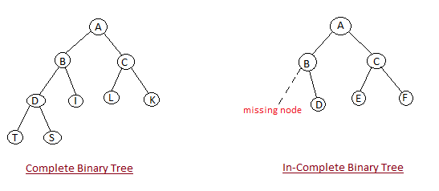
Heap Sort
Shape Property: Heap data structure is always a Complete Binary Tree, which means all levels of the tree are fully filled.

Slide 108
Sample Run
Start with unordered array of data
Array representation:
Binary tree representation:
 | 21 | 15 | 25 | 3 | 5 | 12 | 7 | 19 | 45 | 2 | 9
21
15
25
3
5
12
7
19
45
2
9

Slide 109
Heap Sort - Video link
Heap Sort
https://www.youtube.com/watch?v=H5kAcmGOn4Q

Slide 110
Merge Sort Vs Quick Sort - Video link
Merge Sort Vs Quick Sort
https://www.youtube.com/watch?v=es2T6KY45cA

Slide 111
Additional References
https://www.youtube.com/watch?v=WaNLJf8xzC4

Slide 112
Data Structures

Slide 113

Data Structures
Why Data structure
https://www.youtube.com/watch?v=-q-3b_093do
Watch the Video

Slide 114
Data Structures
Data structures is concerned with the representation and manipulation of data
All programs manipulate data
So, all programs represent data in some way
Data manipulation requires an algorithm
The study of Data Structure is fundamental to computer programming
Notes:
Data: Streets in a city. Mapquest.
Manipulation: Do something with the data. Add a new street. Close a street. Make a street one way. Find route from your home to nearest gas station. Input/output data.
Data representation: simple variables…int, float
array variables… int [], float []
Others to be studied in this course.
Algorithm…sequence of steps that results in the performance of a specific task (find nearest gas station to home).

Slide 115
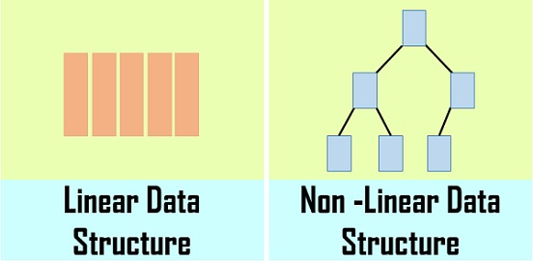
Types of Data Structure
There are basically two types of data structure
1.Linear Data Structure
2.Non-Linear Data Structure.

Slide 116
Basic data structures: data collections
Linear structures
Array: Fixed-size
Linked List: Add to top, bottom or in the middle
Stack: Add to top and remove from top
Queue: Add to back and remove from front
Priority queue: Add anywhere, remove the highest priority
Non- Linear Data Structure
Tree: A branching structure with no loops
Graph: A more general branching structure, with less stringent connection conditions than for a tree

Slide 117
Static vs. Dynamic Structures
A static data structure has a fixed size
This meaning is different from the meaning of the static modifier (variable shared among all instances of a class)
Arrays are static; once you define the number of elements it can hold, the number doesn’t change
A dynamic data structure grows and shrinks at execution time as required by its contents
A dynamic data structure is implemented using links

Slide 118
Array
An array of integers
Age
1
int [ ] Age;
(Arrays are like objects)
Age
[0]
[1]
[2]
[3]
[4]
[5]
[6]
[7]
2
Age= new int[8];
0
0
0
0
0
0
0
0
Age
[0]
[1]
[2]
[3]
[4]
[5]
[6]
[7]
3
Age [3] = 38;
0
0
0
38
0
0
0
0
Declaration
Allocation
Initialization

Slide 119
Linked List
a linked list is a linear collection of data elements, in which linear order is not given by their physical placement in memory.
Elements may be added in front, end of list as well as middle of list.
Linked List may be use for dynamic implementation of stack and queue.

Slide 120
Stack
Stack is a linear data structure which works on LIFO order. So that Last In First Out .
In stack element is always added at top of stack and also removed from top of the stack.
Stack is useful in recursive function, function calling, mathematical expression calculation, reversing the string etc.

Slide 121
Data Structure -- Stacks
LIFO (Last In, First Out) in Stack: The last element inserted will be the first to be retrieved, using Push and Pop
Push
Add an element to the top of the stack
Pop
Remove the element at the top of the stack
empty stack
push an element
push another
pop
top
B
top
top
top
A
A
A

Slide 122
Data Structures -- Stacks
Attributes of Stack
maxTop: the max size of stack
top: the index of the top element of stack
Operations of Stack
empty: return true if stack is empty, return false otherwise
full: return true if stack is full, return false otherwise
top: return the element at the top of stack
push: add an element to the top of stack
pop: delete the element at the top of stack
displayStack: print all the data in the stack

Slide 123
Data Structure -- Stacks
Real life analogy:
Elevator
Dish holders (stacks)
Typical uses of stacks:
Prefix-/Postfix- calculators
Any list implementation could be used to implement a stack
Arrays (static: the size of stack is given initially)
Linked lists (dynamic: never becomes full)

Slide 124
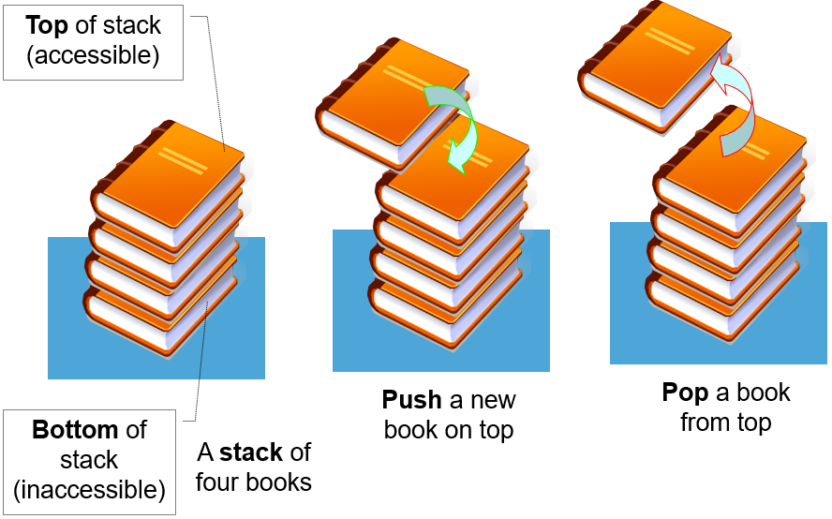
Data Structure -- Stacks

Slide 125
Data Structure -- Queues
Like a stack, a queue is also a list. However, with a queue, insertion is done at one end, while deletion is performed at the other end
The insertion end is called rear
The deletion end is called front
Remove (Dequeue)
Insert (Enqueue)
front
rear

Slide 126
Data Structure -- Queues
Attributes of Queue
front/rear: front/rear index
counter: number of elements in the queue
maxSize: capacity of the queue
Operations of Queue
IsEmpty: return true if queue is empty, return false otherwise
IsFull: return true if queue is full, return false otherwise
Enqueue: add an element to the rear of queue
Dequeue: delete the element at the front of queue
DisplayQueue: print all the data

Slide 127
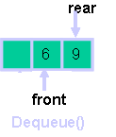
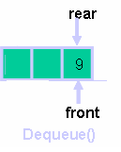
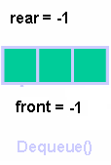
Data Structure -- Queues
Accessing the elements of queues follows a FIFO (First In, First Out) order The first element inserted will be the first to be retrieved, using Enqueue and Dequeue
Enqueue
Add an element after the rear of the queue
Dequeue
Remove the element at the front of the queue
rear
rear
rear
3
3
6
3
6
9
front
front
front
Enqueue(3)
Enqueue(6)
Enqueue(9)

Slide 128
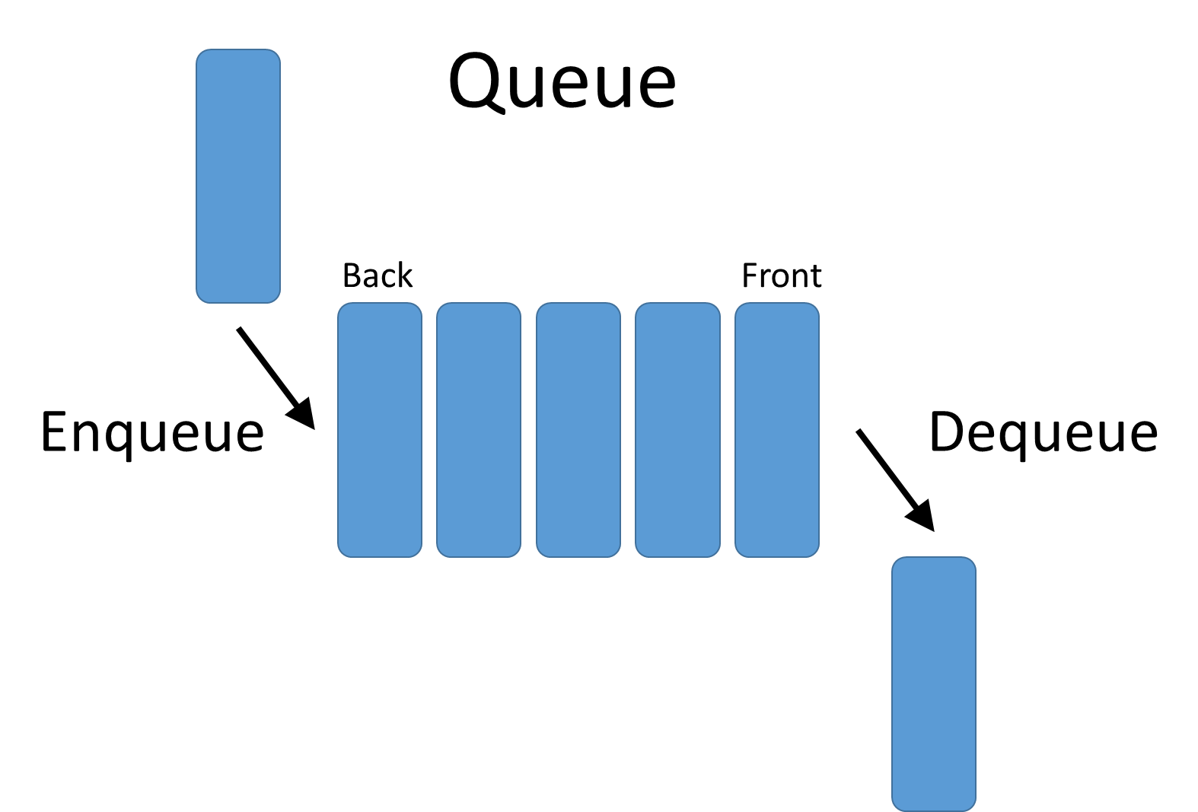

Data Structure -- Queues
Real life analogy:
Check-out lines in a store (queuing up)
Typical uses of queues:
Waiting lists of course registration
Simple scheduling in routers
Any list implementation could be used to implement a queue
Arrays (static: the size of queue is given initially)
Linked lists (dynamic: never becomes full)

Slide 129
Trees
A tree is a non-linear data structure that consists of a root node and potentially many levels of additional nodes that form a hierarchy
Nodes that have no children are called leaf nodes
Non-root and non-leaf nodes are called internal nodes
root node
imagine an upside
down tree
internal nodes
A tree data structure
leaf nodes

Slide 130
Organization chart represented via a tree data structure
PRESIDENT
ROOT NODE
VP
VP
VP
VP
MGR
MGR
MGR
MGR
LEAF NODES

Slide 131
Tree Traversal
Two main methods:
Inorder
Preorder
Postorder
Recursive definition
Inorder
Preorder:
visit the root
traverse in preorder the children (subtrees)
Postorder
traverse in postorder the children (subtrees)
visit the root

Slide 132
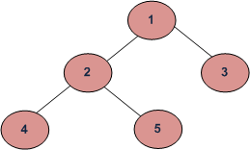
Tree traversal (cont..)
BFS and DFSs of the Tree
Breadth First Traversal : 1 2 3 4 5
Depth First Traversals:
Preorder Traversal : 1 2 4 5 3
Inorder Traversal : 4 2 5 1 3
Postorder Traversal : 4 5 2 3 1

Slide 133
Graph
A graph is a non-linear structure (also called a network)
Unlike a tree or binary tree, a graph does not have a root – no primary entry point.
Any node can be connected to any other node by an edge
Can have any number of edges and nodes
Analogy: the highway system connecting cities on a map
a graph data structure

Slide 134
Summary
Qualities of a software Developer
Problem solving approaches
Problem classification
Flow chart design
Algorithms-Pseudo codes
Algorithm Patterns
Data Structures

Slide 135
Learning material references
Books
“Introduction to Algorithms”, Thomas H Cormen, Charles Leiserson, Ronald Rivest and Clifford Stein, 3rd edition, MIT, July 2009
“Problem Solving Using C: Structured Programming Techniques”, Yuksel Uckan , McGraw-Hill Inc.,1998
"Data Structures and Algorithms Made Easy in Java: Data Structure and Algorithmic Puzzles", Narasimha Karumanchi, areerMonk Publications, 2014
Web
http://www.slideshare.net/dokka/program-design-and-problem-solving-techniques

